Slide 1

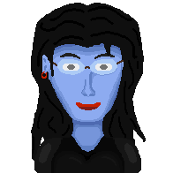

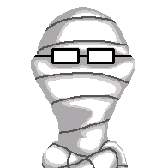

Solarium
Ed Room
Tmp Room
Edwige Room
Edna Room
?
Telescope
Bathroom
Humans corridor
Laundry
Bathroom
Green
Purple
Blue
Study
Cables room
?
?
Infirmary
Tentacles corridor
Suites corridor
Tech Room
Art Room
Music Hall
Arcade Room
Gym
Living room
Upstairs
Corridor
Service room
Dining room
Kitchen
Main Hall
Longue
Library
Tree house
Front door
Start area
Woods
Catacombs
Ezra Berg passage
Underpassage
Dungeon
Basement
Lab Entrance
Secret Lab
Meteor
Garage
Inside Pool
Pool
Look up
Barbecue
Court
Patio
Backyard
Shelter
Greenhouse
Woods
Cemetery

